Slide 1
Network Communication in IPC

Slide 2
Key terms
Network
Internet Domain
IP address
Port
TCP and UDP

Slide 3
Network Communication
A network lets two or more computers communicate and work together.
Processes running on different computers to communicate with one another
Programs such as mail, remote file transfer, and remote login that wish to communicate with other machines.
UNIX has been one of the operating systems where a lot of networking development is done.
UNIX has different ways and programs to use networks.
UNIX System discusses the socket interface in detail on network programming.

Slide 4
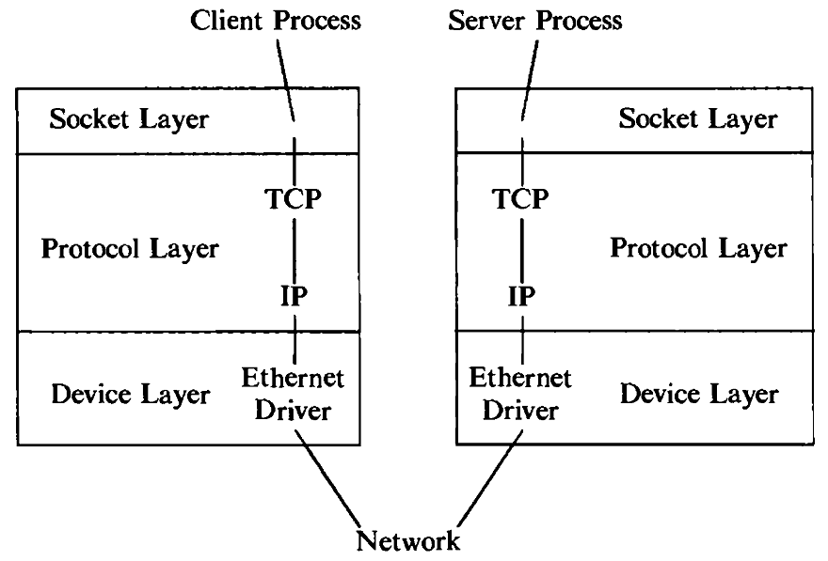
Socket Model
The kernel structure consists of three parts:
The socket layer,
The protocol layer, and
The device layer.
Fig: Socket Model

Slide 5
Socket Model
The socket layer provides the interface between the system calls and the lower layers.
The protocol layer contains the protocol modules used for communication (TCP and IP).
The device layer contains the device drivers that control the network devices.
Fig: Socket Model

Slide 6
TCP vs UDP
Both use port numbers
16-bit unsigned integer, thus ranging from 0 to 65535.
To provide end-to-end transport
UDP: User Datagram Protocol
no acknowledgements
no retransmissions
out of order, duplicates possible
connectionless, i.e., app indicates destination for each packet

Slide 7
TCP vs UDP
TCP: Transmission Control Protocol
reliable byte-stream channel (in order, all arrive, no duplicates)
flow control
connection-oriented
bidirectional

Slide 8
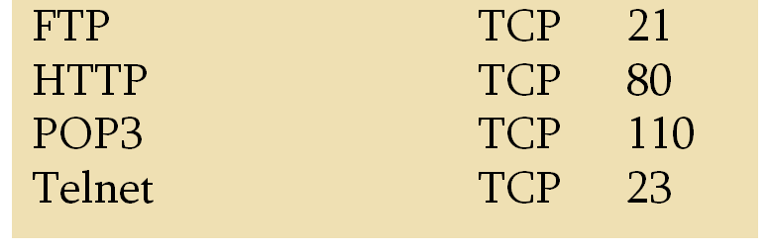
TCP vs UDP
TCP is used for services with a large data capacity, and a persistent connection
UDP is more commonly used for quick lookups, and single use query-reply actions.
Some common examples of TCP and UDP with their default ports:

Slide 9


Socket
A socket is an abstraction of a communication endpoint.
It is an abstraction through which an application may send and receive data.
The kernel maintains internal connections and routes data from client to server.
Application
Application
Socket
Socket
TCP
TCP
IP
Channel
IP
Channel
IP
Router
Host

Slide 10
Socket (contd…)
Processes communicate using the client-server model
A server process listens to a socket, one end point of a two-way communications path, and
Client processes communicate to the server process over another socket, the other end point of the communications path, which may be on another machine.
The kernel maintains internal connections and routes data from client to server.
Application
Application
Socket
Socket
TCP
TCP
IP
Channel
IP
Channel
IP
Router
Host
Source: Google Image

Slide 11
Socket - Type
Two types of sockets
Stream sockets or virtual circuit (e.g. uses TCP)
provide reliable byte-stream service
Datagram sockets (e.g. uses UDP)
provide best-effort datagram service
messages up to 65.500 bytes
Socket extend the convectional UNIX I/O facilities
File descriptors for network communication
Extended the read and write system calls

Slide 12
Socket-Summary
Socket mechanism contains several system calls.
Sockets are a form of interprocess communication that exists between two unrelated processes.
Socket allows us to communicate over the internet using streams or datagrams.
The socket system call establishes the end point of a communications link.
Socket descriptors used to access sockets. Socket descriptors are implemented as file descriptors in the UNIX System.
Many of the functions that deal with file descriptors, such as read and write, will work with a socket descriptor.

Slide 13
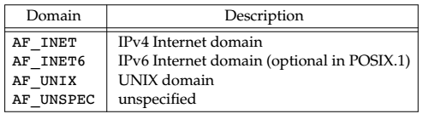
Socket
#include <sys/socket.h>
int socket(int domain, int type, int protocol);
Returns: socket descriptor if OK, −1 on error
The domain argument determines the nature of the communication, including the address format.
The domains specified by POSIX.1. The constants start with AF_ (for address family) because each domain has its own format for representing an address.

Slide 14
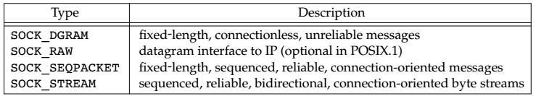
Socket
#include <sys/socket.h>
int socket(int domain, int type, int protocol);
The type argument determines the type of the socket, which further determines the communication characteristics.

Slide 15
Socket
#include <sys/socket.h>
int socket(int domain, int type, int protocol);
The protocol argument is usually zero, to select the default protocol for the given domain and socket type.
When multiple protocols are supported for the same domain and socket type, we can use the protocol argument to select a particular protocol.
The default protocol for a SOCK_STREAM socket in the AF_INET communication domain is TCP.

Slide 16
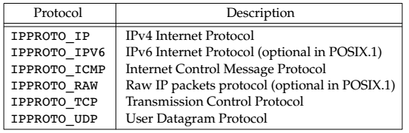
Socket
#include <sys/socket.h>
int socket(int domain, int type, int protocol);
The default protocol for a SOCK_DGRAM socket in the AF_INET communication domain is UDP.

Slide 17
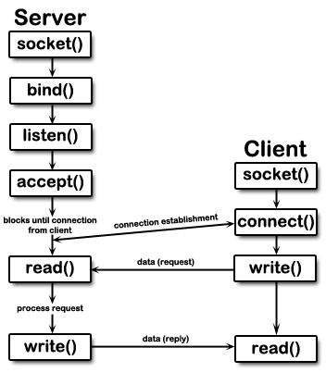
Client Server Model
Diagram shows the approach used for communicate over the internet using streams.
This is only one approach to sockets. Notice that the server is started first; it will accept connections from the client.
Once a connection is established, then communication can occur through the read and write system calls to the file descriptor associated with the socket.
Source: Google Images

Slide 18
Client Server Model
The bind() system call assigns a name to an unnamed socket.
Once you have a socket, associate that socket with a port on local machine.
In the case of the server, it tells the system "this is my address and any messages received for this address are to be given to me”.
Source: Google Images

Slide 19
Used data structures
// IPv4 AF_INET sockets:
struct sockaddr_in {
short sin_family; // e.g. AF_INET, AF_INET6
unsigned short sin_port; // e.g. htons(3490)
struct in_addr sin_addr; // see struct in_addr, below
char sin_zero[8]; // zero this if you want to
};

Slide 20
Used data structures
struct in_addr {
unsigned long s_addr; // load with inet_pton()
};
struct sockaddr {
unsigned short sa_family; // address family, AF_xxx
char sa_data[14]; // 14 bytes of protocol address
};

Slide 21
Associating Addresses with Sockets
#include <sys/socket.h>
int bind(int sockfd, struct sockaddr *my_addr, int addrlen);
Returns: 0 if OK, −1 on error
sockfd is the socket file descriptor returned by socket().
my_addr is a pointer to a struct sockaddr that contains information about address, namely, port and IP address.
The port number in the address cannot be less than 1024, since 0 to 1023 are restricted port numbers are as they are used by well-known protocol services.
addrlen is the length in bytes of that address.

Slide 22
Associating Addresses with Sockets
Listening is used by the server only as a way to get new sockets.
A server announces that it is willing to accept connect requests by calling the listen function.
#include <sys/socket.h>
int listen(int sockfd, int backlog);
Returns: 0 if OK, −1 on error
sockfd is the usual socket file descriptor from the socket() system call.
backlog is the number of connections allowed on the incoming queue.
The backlog argument provides a hint to the system regarding the number of outstanding connect requests that it should enqueue on behalf of the process.
Once the queue is full, the system will reject additional connect requests.

Slide 23
Associating Addresses with Sockets
#include <sys/socket.h>
int accept(int sockfd, struct sockaddr *addr, socklen_t *addrlen);
Returns: file (socket) descriptor if OK, −1 on error
The file descriptor returned by accept is a socket descriptor that is connected to the client that called connect.
This new socket descriptor has the same socket type and address family as the original socket (sockfd).
sockfd is the listening socket descriptor.
If we don’t care about the client’s identity, we can set the addr and addrlen parameters to NULL.
Otherwise, before calling accept, we need to set the addr parameter to a buffer large enough to hold the address and set the integer pointed to by len to the size of the buffer in bytes.

Slide 24
Associating Addresses with Sockets
#include <sys/socket.h>
int accept(int sockfd, struct sockaddr *addr, socklen_t *addrlen);
Returns: file (socket) descriptor if OK, −1 on error
addrlen is a local integer variable that should be set to sizeof(struct sockaddr_storage) before its address is passed to accept().
If no connect requests are pending, accept will block until one arrives.
If a server calls accept and no connect request is present, the server will block until one arrives.

Slide 25
Connection Establishment
If dealing with a connection-oriented network service, then before exchanging data, a connection between the socket of the process requesting the service (the client) and the process providing the service (the server) is created using:
#include <sys/socket.h>
int connect(int sockfd, struct sockaddr *serv_addr, int addrlen);
Returns: 0 if OK, −1 on error
sockfd is our socket file descriptor, as returned by the socket() call
serv_addr is a struct sockaddr containing the destination port and IP address, and
addrlen is the length in bytes of the server address structure.

Slide 26
Connection Close
To close the connection on your socket descriptor.
#include <sys/socket.h>
close(sockfd);
Returns: 0 if OK, −1 on error
Close() prevent any more reads and writes to the socket.
Just in case you want a little more control over how the socket closes, you can use the shutdown() function

Slide 27
Socket shutdown
Shutdown the Socket.
#include <sys/socket.h>
int shutdown(int sockfd, int how);
It returns 0 on success, and -1 on error
SHUT_RD: then reading from the socket is disabled.
SHUT_WR: then we can’t use the socket for transmitting data.
SHUT_RDWR: to disable both data transmission and reception.

Slide 28
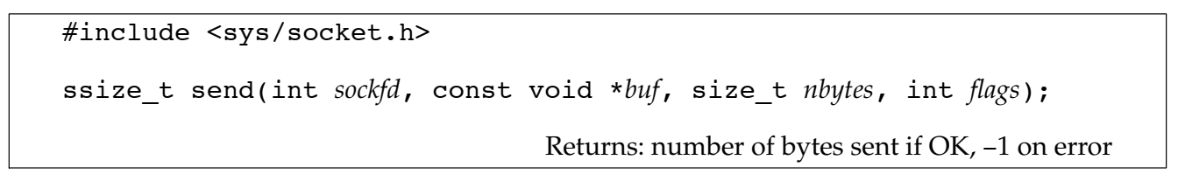
Data Transfer
Parameters:
sockfd is the socket descriptor you want to send data to buf is a pointer to the data you want to send, and len is the length of that data in bytes.
send() returns the number of bytes actually sent out.
If send returns success, it doesn’t necessarily mean that the process at the other end of the connection receives the data. All we are guaranteed is that when send succeeds, the data has been delivered to the network drivers without error.

Slide 29
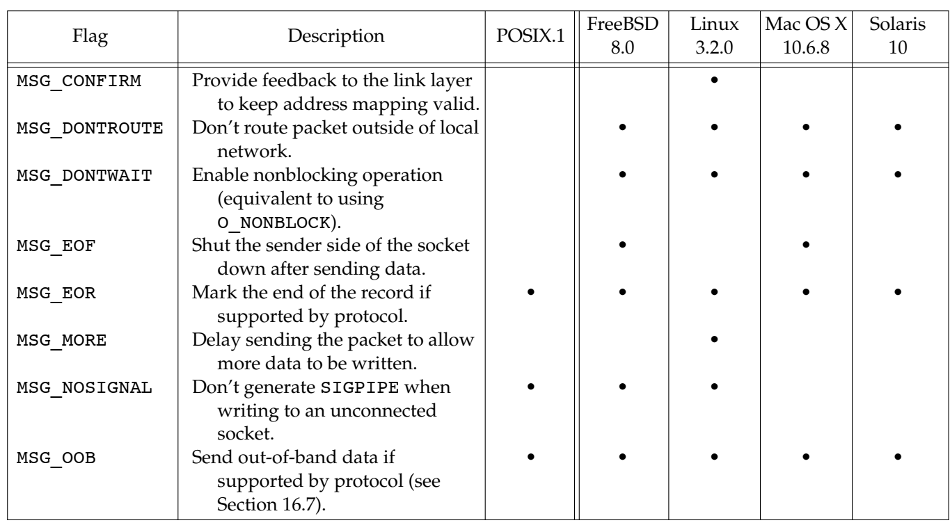
Data Transfer
Flags used with send socket calls

Slide 30
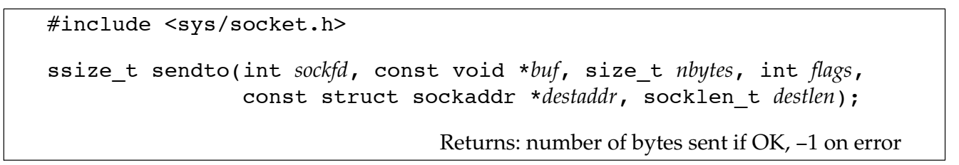
Data Transfer
Function is similar to send.
The difference is that sendto allows us to specify a destination address to be used with connectionless sockets.
With a connection-oriented socket, the destination address is ignored, as the destination is implied by the connection.
With a connectionless socket, we can’t use send unless the destination address is first set by calling connect, so sendto gives us an alternate way to send a message.

Slide 31
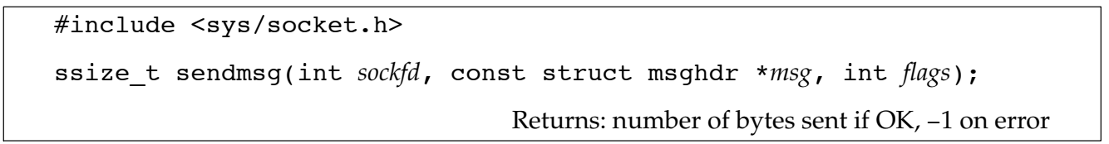
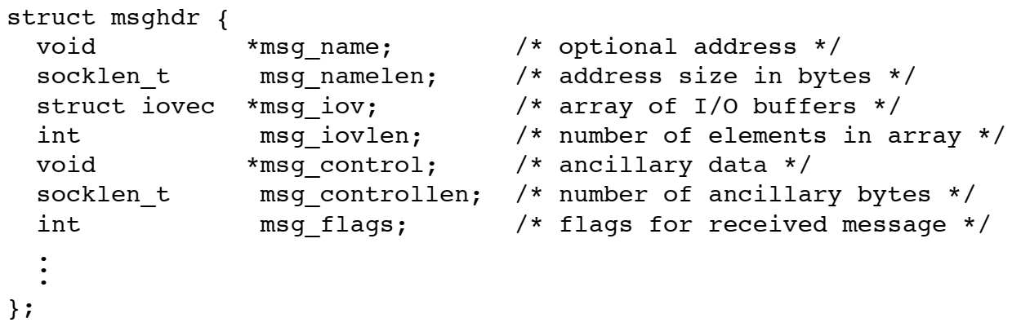
Data Transfer
msghdr to specify multiple buffers from which to transmit data

Slide 32
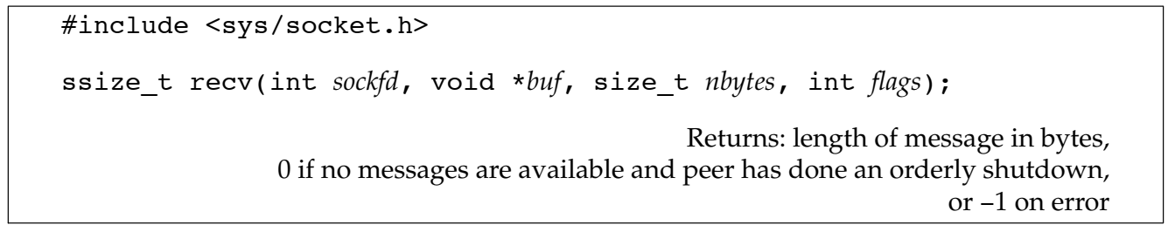
Data Transfer
sockfd is the socket descriptor to read from, buf
buf is the buffer to read the information.
nbytes is the maximum length of the buffer
recv() returns the number of bytes actually read into the buffer.

Slide 33
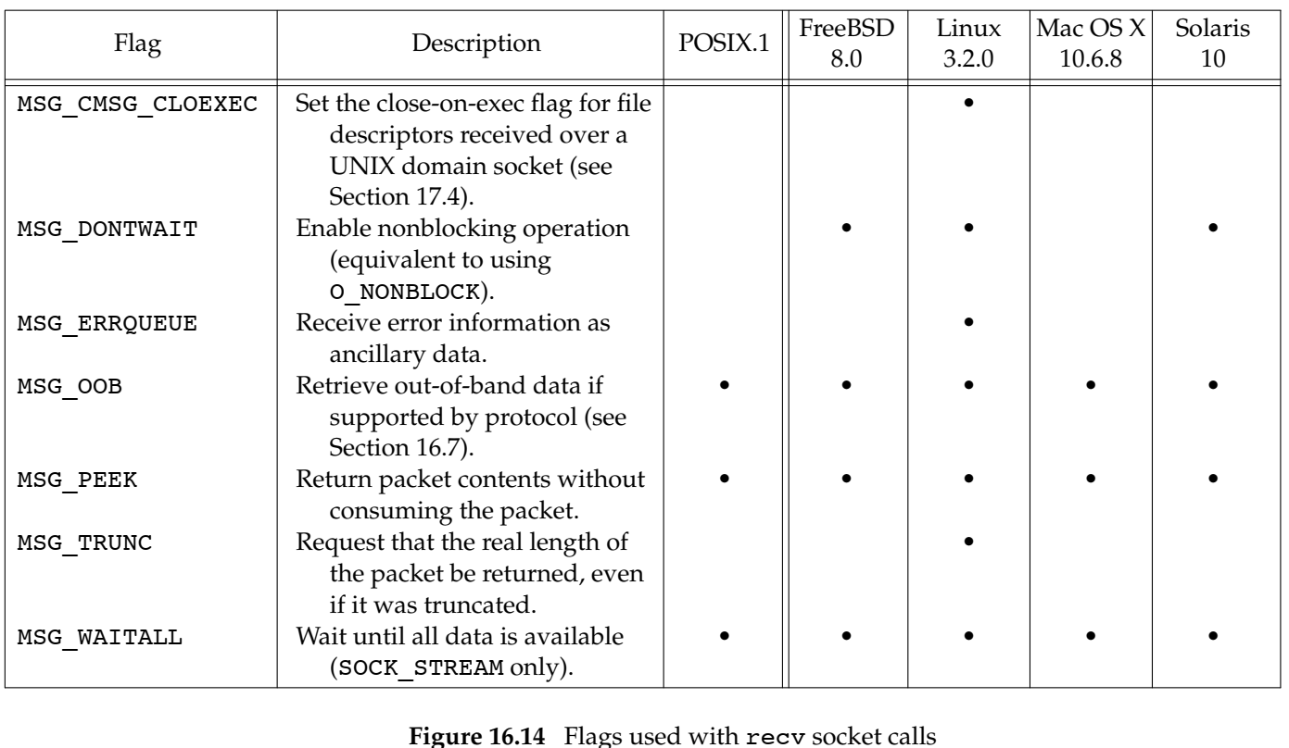
Data Transfer

Slide 34
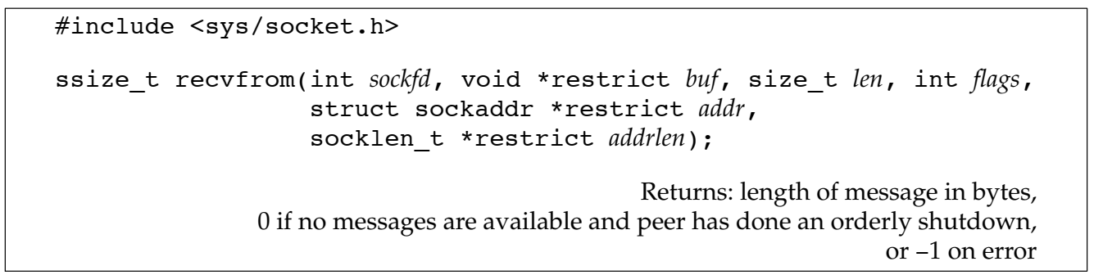
Data Transfer
Use recvfrom to obtain the source address from which the data was sent
If addr is non-null, it will contain the address of the socket endpoint from which the data was sent.
When calling recvfrom, addrlen parameter is set to point to an integer containing the size in bytes of the socket buffer to which addr points.
On return, the integer is set to the actual size of the address in bytes.

Slide 35
Data Transfer
recvfrom is typically used with connectionless sockets. Otherwise, recvfrom behaves identically to recv.
It allows us to retrieve the address of the sender,

Slide 36
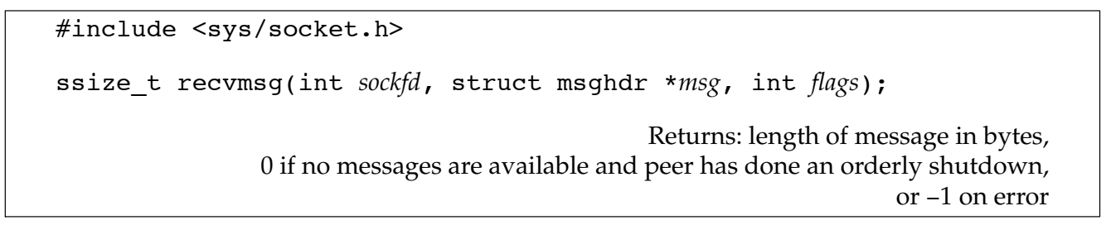
Data Transfer
recvmsg is used to receive data into multiple buffers
The msghdr structure (which we saw used with sendmsg) is used by recvmsg to specify the input buffers to be used to receive the data
flags argument used to change the default behavior of recvmsg.

Slide 37
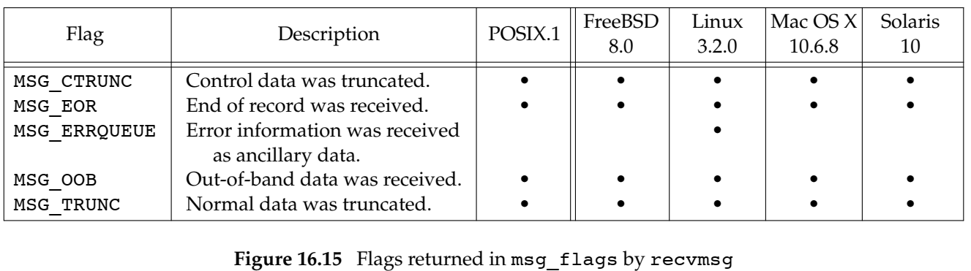
Data Transfer
The possible values on return from recvmsg are

Slide 38
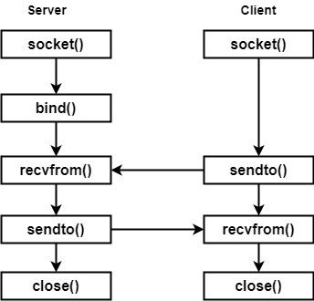
IPC using Datagram
In Datagram (UDP), the client does not form a connection with the server.
Server need not accept a connection and just waits for datagrams to arrive.
Datagram sockets aren't connected to a remote host
Source: Google Images

Slide 39
IPC using Datagram
Fig: IPC using TCP model
Fig: IPC using UDP model
Source: Google Images

Slide 40
IPC using Datagram
Server side:
Steps of establishing a UDP socket:
Create a socket with the socket() function;
Bind the socket to an address using the bind() function;
Send and receive data by means of recvfrom() and sendto().
Client side:
Steps of establishing a UDP socket communication:
Create a socket using the socket() function;
Send and receive data by means of the recvfrom() and sendto() functions.

Slide 41
UDP sockets
UDP Send and receive messages from a socket whereas TCP Send and receive messages from a connected socket.
UDP the client does not establish a connection with the server. Instead, the client just sends a datagram to the server using the sendto function which requires the address of the destination as a parameter.
Similarly, UDP server does not accept a connection from a client.
Instead, the server just calls the recvfrom function, which waits until data arrives from some client. recvfrom returns the IP address of the client, along with the datagram, so the server can send a response to the client.

Slide 42
Implementation of socket() for Server
int socket(int family, int type, int protocol);
s = socket(AF_INET, SOCK_STREAM, 0);
AF_INET (IP V4) indicates that the socket will be created in the internet domain.
SOCK_STREAM indicates that it will be a connection-orient protocol (you can use reads and writes as opposed to sending datagrams)
0 indicates to automatically fill in the protocol, which will be TCP when SOCK_STREAMS are used.
IPPROTO_TCP or IPPROTO_UDP
s is a small integer value, called socket descriptor.

Slide 43
Implementation for Server
s = socket(AF_INET, SOCK_STREAM, 0);

Slide 44
Implementation of bind()
The bind() assigns a name to an unnamed socket.
int bind(int sockfd, const struct sockaddr *my_addr, int addrlen);
bind(s,(struct sockaddr *)&saddr, sizeof(saddr))
saddr is actually a sockaddr_in structure (for the internet domain), thus casting is required. A sockaddr_in structure looks like this:
struct sockaddr_in {
short sin_family; /*Set to AF_INET*/
u_short sin_port; /*Set to zero so can assign an unused port*/
struct in_addr sin_addr; /*Set to the host*/
char sin_zero[8]; /*unused*/
};
both an address and a port number required for the internet domain-AF_INET

Slide 45
Implementation for Server
s = socket(AF_INET, SOCK_STREAM, 0);
bind(s,(struct sockaddr *)&saddr, sizeof(saddr))

Slide 46
Implementation of listen()
This system call is used by a connection-oriented server to indicate that it is willing to receive connections.
int listen(int sockfd, int backlog);
listen(s,1)
s is our "socket descriptor"
The second parameter specifies how many pending requests for connection can be queued by the system (in this example, only one)

Slide 47
Implementation for Server
s = socket(AF_INET, SOCK_STREAM, 0);
bind(s,(struct sockaddr *)&saddr, sizeof(saddr));
listen(s,1);

Slide 48
Implementation of accept ()
This system call is used by a connection-oriented server to indicate that it is willing to receive connections.
int accept(int sockfd, struct sockaddr *addr, socklen_t *addrlen);
sfd = accept(s,NULL,NULL);
the addr and addrlen are NULL. If we wanted to get information about client process, then we would send a pointer to a sockaddr struct.

Slide 49
Implementation for Server
s = socket(AF_INET, SOCK_STREAM, 0);
bind(s,(struct sockaddr *)&saddr, sizeof(saddr));
listen(s,1);
sfd = accept(s,NULL,NULL);

Slide 50
Implementation of Socket () for Client
s1 = socket(AF_INET, SOCK_STREAM, 0);
int connect(int sockfd, const struct sockaddr *serv_addr, int addrlen);
The connect() establishes a connection between the client and the server.
connect(s1,(struct sockaddr *)&bba,sizeof(bba));
bba is actually a sockaddr_in structure.
bba has been filled in with the ip address and port number of the server.

Slide 51
Implementation for Client
s1 = socket(AF_INET, SOCK_STREAM, 0);
connect(s1,(struct sockaddr *)&bba,sizeof(bba));

Slide 52
Communication
send(int socket, const void *message, size_t length, int flags)
recv(int socket, void *buffer, size_t length, int flags);

Slide 53
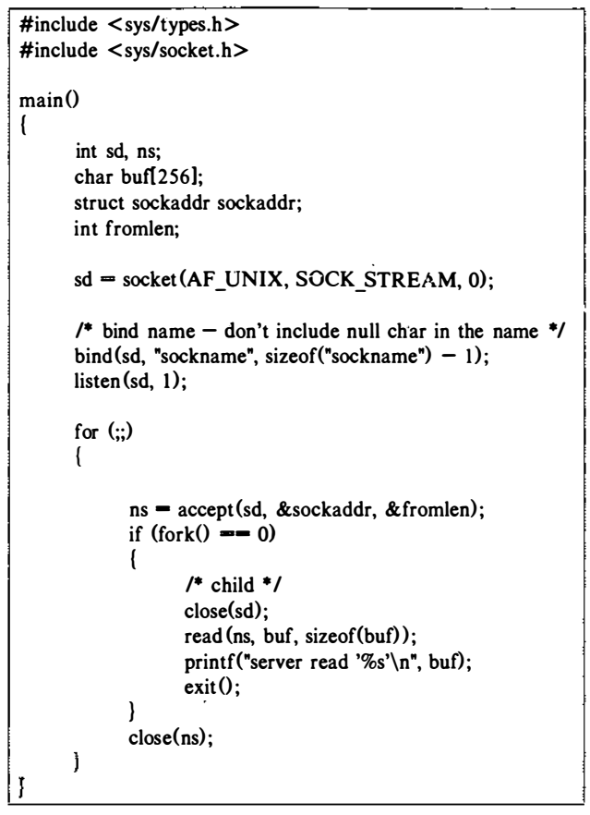
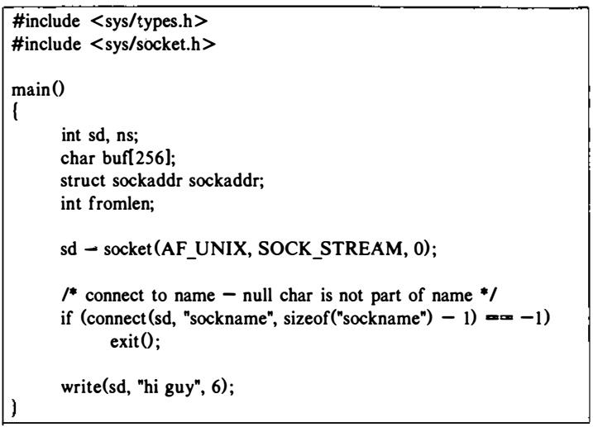
Network Communication in IPC in UNIX
A Client Process in the UNIX System Domain
A Server Process in the UNIX System Domain

Slide 54
Reference
The Design of the UNIX Operating System, by Maurice J. Bach
Advanced Programming in the UNIX ® Environment, by W. Richard Stevens, Stephen A. Rago
https://www.binarytides.com/socket-programming-c-linux-tutorial/

